Slide 1
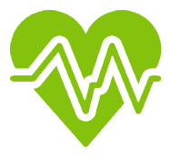


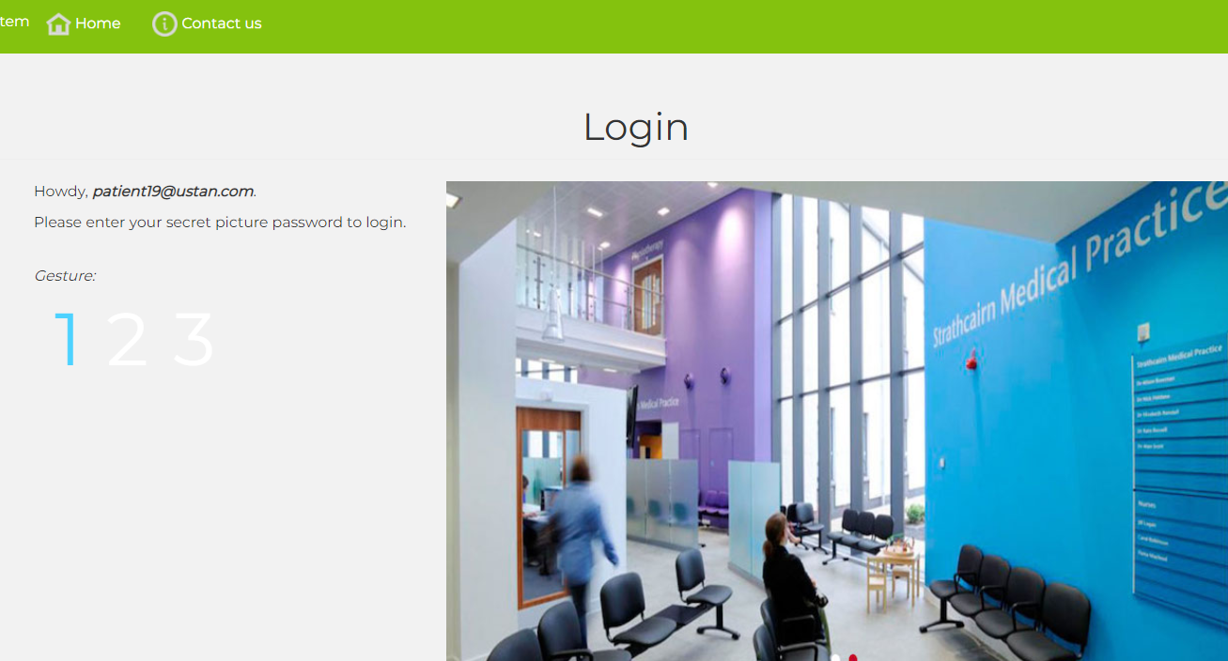
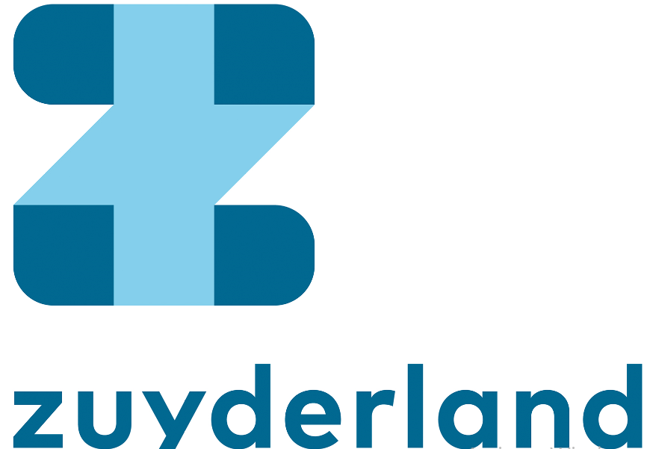

Newsletter EU Serums – March 2022
SERUMS
SHARING PATIENT DATA IN A SAFE AND SECURE WAY ACROSS EUROPE
www.serums-h2020.org/
https://www.youtube.com/channel/UC-Cwk8RyJ4Q_atLsSDBL0vA
https://mobile.twitter.com/serums_h2020
Public participatory testing of the Serums system,
University of St Andrews
Due to the ongoing Covid-19 pandemic, currently accepted face to face models of public system testing within healthcare settings have become temporarily unfeasible. In order to overcome this challenge, Serums uses an online participatory approach to evaluate the integrated system. Online technical support teams used a social media based approach to recruit members of the public and support them remotely in exploring and testing the system. The intention of the exercise was to ascertain public perception of the platform in terms of system security, and usability of the technologies, and establish what the level of public trust may be in the system. Public feedback is invaluable in designing, developing, improving and refining user-friendly features whilst analysing and mitigating interoperability issues within Serums system.
Participants were interviewed in real time by video link on Teams, where volunteers were given access to the Serums platform for the first time, supported by trained members of the project. Read more >>> (link to full article)
Serums System Validation and Verification Eduard Baranov,
Université Catholique de Louvain
Modern systems are often composed of multiple concurrent components based on various technologies. As a result, verification ensuring correctness and security of such systems is complex. Bugs and vulnerabilities can appear not only within a single component but during the interactions between components as well. Therefore, verification of separate components is not sufficient, the complete system requires checking. For a healthcare system, correctness and security are of utmost importance. Operating on medical data, an error could have catastrophic consequences. At the same time, high level of privacy is also required: the system must prevent data leaks.
One of the approaches we use to ensure correctness and security of the SERUMS system is Model Checking (MC) that provides mathematical guarantees about the properties satisfaction. The approach requires building a model of the system in a formal language where no ambiguity or undefined behaviours are allowed. The desired properties are also formalised and checked on the model by exploring its reachable states. MC is an extremely powerful approach however it suffers from a so-called state space explosion: computational expensiveness makes the approach infeasible on large systems. In order to avoid the limitation, we use statistical model checking (SMC) - an alternative approach that combines ideas from MC with statistics. Read more >>> (link to full article)
Previous & Upcoming Events
January update of use cases encompassing cross country and access rules across borders
May Release of public dissemination animation
February commencement of weekly meeting to plan POC
March 23rd Preparation and execution of 2nd public system testing St Andrews
February Preparation and execution of 2nd public system testing FCRB and ZMC
Virtual EU Grant Review Meeting
December 2021
6-7 December 2021
10th International Symposium
DATAMOD 2021
FROM DATA TO MODELS AND BACK
A satellite event of the
19th International Conference of Software Engineering and Formal Methods - SEFM 2021
June Final press release- End of Serums Project
March 2022
December 2021
Zuyderland in the Serums Project, Leon Van de Weem, Zaans Medisch Centrum
Zuyderland is a large Healthcare organisation in the South of the Netherlands. We have three pillars, namely Cure, Care and Homecare. We employ almost 10,000 people, making ZMC the largest employer in our region. Because we are situated in the south of the Netherlands, sandwiched between Germany and Belgium, exchanges between patients take place on a regular basis. While in the Netherlands we are in the process of developing a national standard for exchanging medical data (the MedMij standard), we do not have standards in place with our neighbouring countries. Given our vision of "The best care as close to home as possible", it is important that medical data can be shared securely with our patients and other healthcare professionals. That is why we were keen to participate in the Serums Project. At Zuyderland, we are responsible for the requirements and evaluation of the Serums system. To this end, we created requirements for all the technologies based on the GDPR and our strict national regulations on medical data. To evaluate the requirements in a real-life setting, we created a Use Case where we can follow the medical data from a fictitious patient through the system. The medical data was fabricated using the IBM tool and is based on anonymized data from patients. To carry out the evaluation, we have already held two Proof of Concepts, in which we showed the system to about 30 patients and questioned them about it. We also showed several healthcare providers and ICT personnel the system through the eyes of the Use Case patient. These results were published and obtained using validated questionnaires. Meanwhile, we are on the eve of our final Proof of Concept where the complete system will be tested, and our fictional patient in our Use Case exchanges medical data with foreign countries. We expect that through our participation in this project we can make a significant contribution to a system and standard where medical data can be exchanged securely worldwide.
Evaluation of Serums in Real Life Settings, Santiago Iriso, Hospital Clínic de Barcelona
As one of the parties within Serums European Project, the Hospital Clínic de Barcelona use case study aims to demonstrate the potential of the Serums system to be used for patients and healthcare professionals. Two proof of concept were held to test the security and confidentiality of the system in a local environment.
The Serums Hospital Clinic use case proof of concept, has given the opportunity to be tested by all the users, obtaining promising results. The next challenge is to be tested as a secure system, that can be used by the patient and the healthcare staff, to share personal and health information within Europe, between different healthcare staff and hospitals around Europe. For this proof of concept, the Serums system will emulate that the patient is selecting which personal data will share with another professional within different countries. The main aim of this is to measure the security and trust of the Serums system in an international scenario. Serums project is giving Hospital Clinic de Barcelona the opportunity to test in a secure and experimental environment the efficiency, robustness and trust to share information in a local entity and also across healthcare providers from different countries.
The Serums system is inside the hospital IT strategy to study as a possible solution for the Hospital needs, due to that at present, the medical data is not shared outside the Hospital ecosystem and, many times, the patient needs to share his own personal data to another healthcare provider.

Slide 2

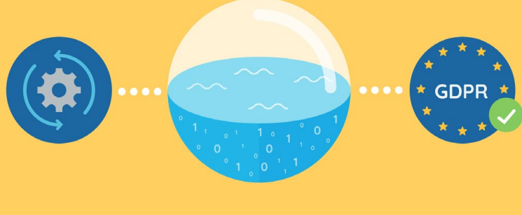
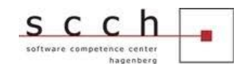
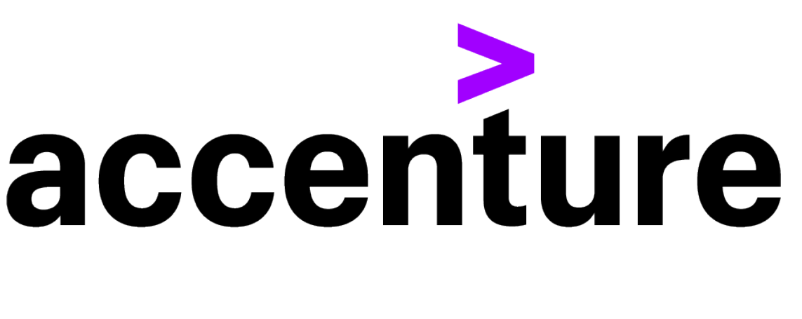




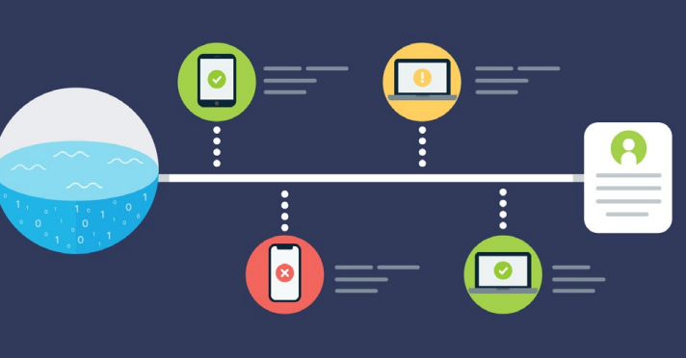
Newsletter EU Serums – March 2022
SERUMS
SHARING PATIENT DATA IN A SAFE AND SECURE WAY ACROSS EUROPE
www.serums-h2020.org/
https://www.youtube.com/channel/UC-Cwk8RyJ4Q_atLsSDBL0vA
https://mobile.twitter.com/serums_h2020
Software development, Euan Blackledge, Soprasteria
Since our last update, Work Package 2 has continued to works towards the final versions of the software. A large part of this work has been ensuring it is ready for integration between the various other components in the Serums ecosystem. Primarily, this has focussed on the linkages between the data lake API and the authentication and blockchain modules.
The data lake now uses the JWT tokens supplied by the authentication module during multiple phases of the data retrieval to ensure that the requestor is a valid user and with the correct permissions. Furthermore, the data lake also updates the blockchain throughout the process in order to track the provenance and lineage of the data as it makes it’s way from a hospital’s data lake to the end user.
Each little step towards the final platform has seen its share of challenges as we continue to work as discrete teams split across multiple countries. However, it has also been a wonderful experience to pull together and tackle some of these challenges head on.
The final task of the work package is also in the early stages of development. This relates to metadata extraction with an aim to automate the process of mapping the source data to our desired output format. This is being led by the team at Dundee with some assistance from SCCH and we eagerly await their results. As we end the development cycle for the project, we are beginning to turn our attention to the possible exploitation of the various technologies. This involves exploring potential changes to the languages that the components have been written in, as well as exploring methods that would enable us to rapidly scale the platform.
Public dissemination animation
Emma Morley, University of St Andrews
The University of St Andrews team is currently working on the creation of another ‘Explainer Animation’ to aid public dissemination. The animation was to include sections of in person interviews with health professionals, patients and hospital IT specialists but ongoing covid restrictions prevented this. The animation discusses how sharing medical records with health professionals improves medical care and how Serums developed the multi-national system for patients and doctors to manage and share medical information, to optimise care while protecting privacy and security.
The animation describes the concept of the data lake to the public in understandable terms and details the use of synthetic data to create and test the system. Serums is described in terms of how it gives patients control over their medical information and how it allows them to securely share medical data. It describes the picture password creation process to public laypersons and discusses data privacy and security. It also informs people how patients can choose which hospital departments or other medical organisations have access to their ‘data lake’ records and how much they can see and introduces the concept of blockchain to define access rules for patient data, giving an undisputed audit-trail for attempts to access medical records.
The animation (examples of storyboard below) describes how Serums will be used in the real world, with synthetic data replaced by real patient’s medical data and gives public feedback from system testing.
Privacy preserving, Michael Rossbory, SCCH
In our work package we research novel approaches to allow for statistical and computational analysis of sensitive or private data, while assuring preservation of privacy of the data owner. In the first period of the project, we developed a novel approach of how to achieve a high level of privacy by adding noise to the data in an optimal way to tackle the issue of the privacy-accuracy tradeoff.
In the second period we focused on novel approaches of distributed privacy-preserving transfer and multi-task learning. Using our optimal noise-adding mechanism to keep perturbation of data as small as possible, we developed a framework that ensures a high level of privacy without degrading learning performance, is capable of handling high-dimensional data and heterogeneity of domains and allows learning of the target domain model without requiring an access to source domain private training data.
In addition to the possibility of achieving privacy by adding noise to data we also addressed the problem of
practical secure privacy-preserving distributed machine (deep) learning using fully homomorphic encryption. Read more >>>
Update to Blockchain Bram Elshof, Accenture
The Blockchain stores granular patient-health-record access rules which enables patients to choose which hospital departments or other medical organisations will have access to their records. They cannot be altered by anyone without creating an auditable trail. Authorised professionals access information in the data lake based on the level of permission the patient grants them. Each time a patients’ information is accessed, an undeletable log is written to the blockchain.
Additionally, the blockchain is now able to provide trustworthy information about a patient-health-records’ provenance. When a Serums user requests a patient’s data, their health record is created on-demand by the data lake. This process involves multiple steps, like requesting and receiving data from the respective hospital databases, putting them into a unified Serums structure and encrypt them before they are send back to the requestor. All these steps are now notarized on the Serums Blockchain, providing an undisputed audit-trail.
Many small but still noteworthy features where added to the Blockchain. Rule records now include the serums-ID of the user who initially Read more >>>
FlexPass System Update Marios Belk, University of Cyprus
The final version of the Serums' FlexPass user authentication system has been implemented with several improvements aiming to achieve a balance between security and usability. FlexPass is a novel knowledge-based user authentication system that combines personalized graphical passwords and textual passwords under a unified framework, enabling users to choose their preferred user authentication type based on their preference and context of use. The final FlexPass system has been enhanced with an improved smartphone application (Serums Authenticator), which adds a second layer for security, enabling users to easily approve their logins through a usable and secure push notification technology, a password strength meter, which provides instant feedback to users on the strength of their user-chosen graphical and textual passwords, and a standalone image semantic data analysis tool for assisting system administrators to retrieve best-fit images for users. FlexPass has been smoothly integrated to the rest components of Serums, and it is currently being setup and fine-tuned for its final evaluation as part of the Serums' third and final proof of concept (PoC3) user evaluation study, in which FlexPass will be evaluated by real patients at the three partner healthcare organizations of Serums. In PoC3, we plan to evaluate the security strength of user-chosen passwords, the perception of end-users towards the system’s usability, privacy and trust, its resistance to social engineering attacks, as well as evaluate the effectiveness of the various technologies of FlexPass.

